Slide 1

KIET Group of Institutions, Ghaziabad
(An ISO – 9001: 2008 Certified & ‘A+’ Grade accredited Institution by NAAC)
Alumni Association Platform for the university/institute
This project aims to Create a robust, interactive platform to foster engagement, networking, and support between alumni and students.
Submitted by:
1.Vaibhav Rai(2100290120182)
2.Vivek Singh(2100290120194)
3.Vijay Chaursiya(2100290120188)
4.Tushar Sahani(2100290120175)

Slide 2
Problem Statement
Many universities face challenges in managing and organising alumni information due to the lack of efficient alumni association applications. While various alumni association portals are available, most fail to provide a comprehensive solution. These systems often grant sole authority to administrators for updating alumni data, leaving alumni unable to edit their personal information. Such limitations lead to inefficiencies, as retrieving alumni details becomes a slow process, and there is often no guarantee of data confidentiality. Additionally, traditional portals are largely static, serving primarily as an information repository about the institution. They lack interactive features and fail to actively engage alumni, current students, and faculty. This absence of interaction limits the platform's potential to foster a robust and interconnected community. A more dynamic and inclusive approach is required to create platforms that effectively bridge these gaps, ensuring better engagement and collaboration among all stakeholders.

Slide 3
Project Abstract
Overview
Key Objectives
Approach
This platform includes web applications with functionalities such as login/registration, donation portal, job portal, networking hub, and alumni directory. It aims to enhance alumni engagement, community building, and career networking.
1.Facilitate Alumni-Student Interaction
2.Support Career and Networking Opportunities
3.Promote Philanthropic Activities
4.Track Alumni Success and Achievements
Development: Establish web with integrated functionalities.
Sustainability: Continuous updates and user feedback incorporation.

Slide 4

Technology Used
Project Goals and Objectives
Increase alumni engagement.
1
2
Foster student career advancement.
Build an online community for
knowledge sharing
3

Slide 5
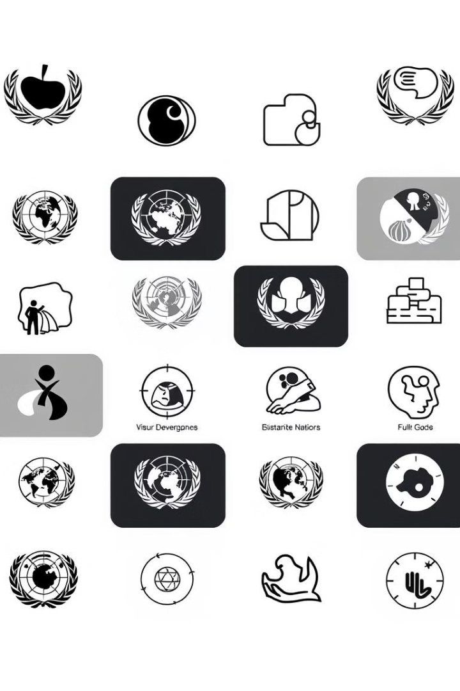
Alignment with UN Sustainable Development Goals (SDGs)
SDG 4 : Quality Education
Goal:Promote lifelong learning opportunities by enabling knowledge sharing, mentorship, and career guidance from alumni to students.
Platform Role: The platform facilitates alumni-student interactions that support academic growth, career preparation, and skill development
SDG 8: Decent Work and Economic Growth
Goal: Support employment opportunities and economic growth.
Platform Role: Through the job portal and networking hub, alumni can post job opportunities, provide industry insights, and help students transition smoothly into the workforce.

Slide 6
SDG 11: Sustainable Cities and Communities
Education
Goal: Strengthen community bonds and promote sustainable development.
Platform Role : By connecting alumni to support current students and contribute to community projects, the platform strengthens the college community and fosters a culture of giving back.
SDG 17: Partnerships for the Goals
Goal: Enhance partnerships to achieve the SDGs.
Platform Role : The platform fosters partnerships between alumni, students, and faculty, encouraging collaboration and shared goals, such as education, career development, and alumni contributions for college projects..

Slide 7




Methodology and Approach
User- Centric Design
Implement user-friendly interfaces
Data Integration
Maintain secure records
Engagement Tools
Use notification, forums and chat features.

Slide 8




Data Flow Diagram
Expected Outcomes and Impact
Increased alumni
involvement
Enhanced student carrier
opportunities
Stronger college
community

Slide 9
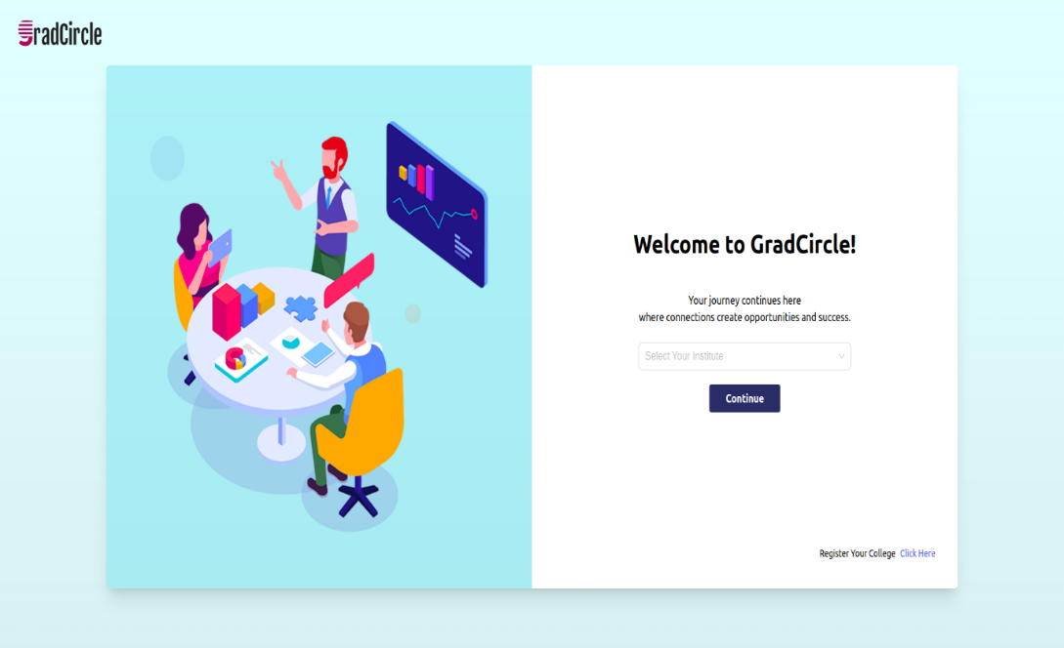
Landing Page

Slide 10
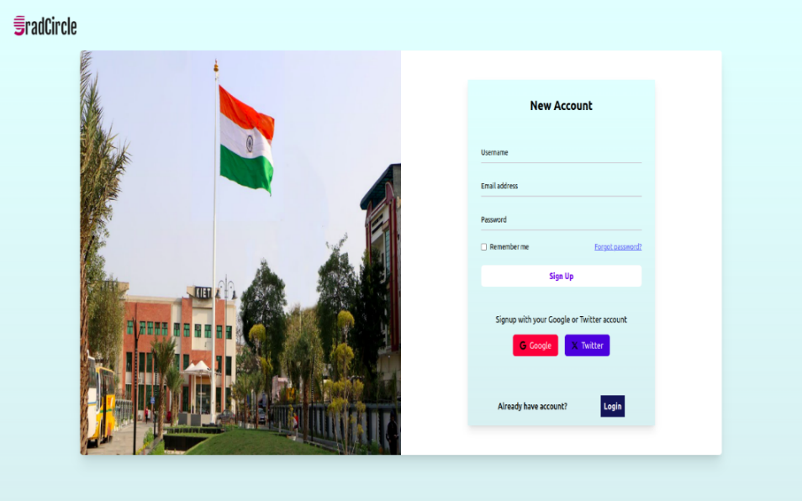
User Registration Page

Slide 11
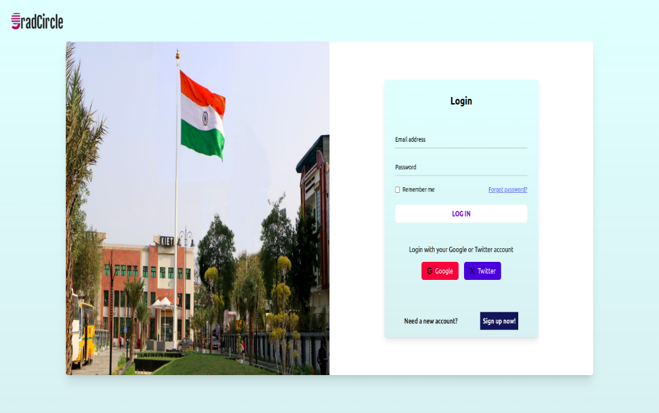
User Login Page

Slide 12
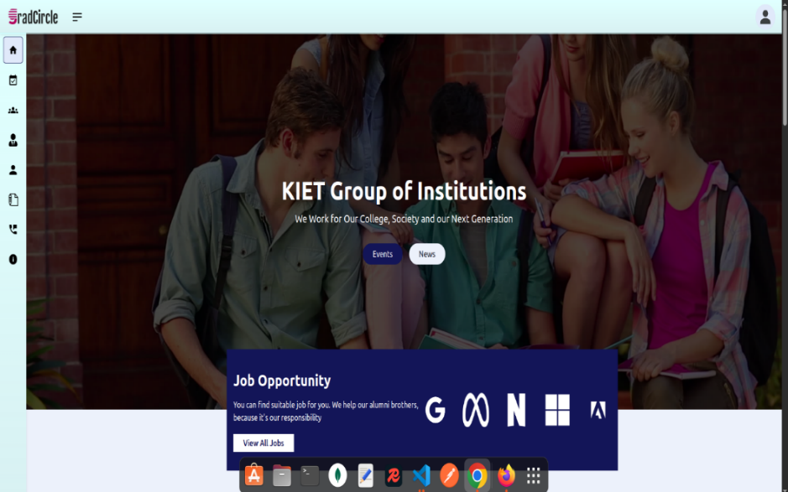
Main Dashboard

Slide 13
References
[1] A. Kumar, S. Sharma, and R. Verma, “Alumni Connect: A Comprehensive Alumni Association Platform for Enhanced Networking and Engagement,” 2022 International Conference on Innovations in Information Technology (ICIT), pp. 45–51, Nov. 2022, doi: 10.1109/icit.2022.9436783.
[2] R. Gupta, M. Joshi, and P. Mehta, “Building Strong Alumni Networks: A Web-Based Platform for Career Development and Social Engagement,” International Journal of Web-Based Communities, vol. 18, no. 3, pp. 145–157, Jun. 2021, doi: 10.1504/ijwbc.2021.115876.
[3] N. Patel, K. Joshi, R. Deshmukh, and M. Gupta, “AlumniHub: A Digital Platform for Alumni Networking, Events, and Professional Growth,” 2023 6th International Conference on Digital Communication and Network Technology (DCNT), pp. 212–219, Mar. 2023,
doi: 10.1109/dcnt.2023.9332104.
[4] S. Reddy, T. Patel, and V. K. Singh, “SocialLink: A Social Platform for Strengthening Alumni Relations Through Digital Tools,” Journal of Online Communities, vol. 11, no. 4, pp. 99–106, Dec. 2020, doi: 10.1080/joc.2020.1124332.

